Slide 1
Object Oriented Programming

Slide 2
Types of Inheritance
C++ supports six types of inheritance as follows:
Single Inheritance
Multilevel Inheritance
Multiple Inheritance
Hierarchical Inheritance
Hybrid Inheritance

Slide 3
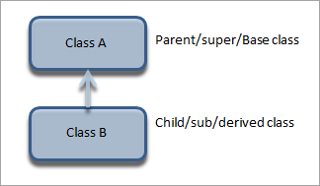
Single Inheritance
A derived class with only one base class is called single inheritance.

Slide 4
Example: Single inheritance
Syntax:
class A // base class
{
..........
};
class B : acess_specifier A // derived class
{
...........
} ;

Slide 5
Example: Single inheritance
Write Two classes A and B.
A = base class
B = derived class
add value to two numbers a and b.
a is the data member of class A and b is the data member of class B

Slide 6
Example: Single inheritance (main.cpp)
#include<iostream>
#include "Header.h"
using namespace std;
int main()
{
B obj2;
obj2.set_data(10);
obj2.get_data();
obj2.set_data2(20);
obj2.get_data2();
obj2.sum();
}

Slide 7
Example: Single inheritance (Header.h)
#pragma once
using namespace std;
class A {
private:
int a;
public:
void set_data(int aa);
int get_data();
};
class B : public A {
private:
int total;
int b;
public:
void set_data2(int bb);
int get_data2();
void sum();
};

Slide 8
Example: Single inheritance (Source1.cpp)
#include<iostream>
#include "Header.h"
using namespace std;
void A::set_data(int aa)
{
a = aa;
}
int A::get_data()
{
return a;
}
void B::set_data2(int bb)
{
b = bb;
}
int B::get_data2()
{
return b;
}
void B::sum()
{
total = get_data() + b;
cout << " Sum of two classes is: " << total << endl;
}

Slide 9

Example: Single inheritance (output)

Slide 10
Class Activity
C++ Program to Inherit a Student class from Person Class printing the properties of the Student.
Person class has
private data member
char fname,lname,gender;
protected data member
Age
Public data member
void input_person()
void display_person()
Students class has
private data member
college_name
level
Public data member
void input_student()
void display_student()

Slide 11
Example: Single inheritance (main.cpp)
#include<iostream>
#include "Header.h"
using namespace std;
int main()
{
student obj1;
obj1.input_person();
obj1.input_student();
obj1.display_person();
obj1.display_student();
cout << endl;
system("pause");
}

Slide 12
Example: Single inheritance (Header.h)
#pragma once
using namespace std;
class person {
private:
char* f_name;
char* l_name;
char* gender;
protected:
int age;
public:
void input_person();
void display_person();
};
class student : public person {
private:
char* college_name;
char* level;
public:
void input_student();
void display_student();
};

Slide 13
Example: Single inheritance (Source1.cpp)
void student::input_student()
{
college_name = new char[20];
cout << " Enter Your college_name: ";
cin.ignore();
cin.getline(college_name, 20);
level = new char[20];
cout << " Enter Your level: ";
cin.getline(level, 20);
}
void person::display_person()
{
cout << " Displaying Data: " << endl;
cout << " First Name is: " << f_name << endl;
cout << " Last Name is: " << l_name << endl;
cout << " Gender is: " << gender << endl;
cout << " Age is: " << age << endl;
}
#include<iostream>
#include<string>
#include<string.h>
#include "Header.h"
using namespace std;
void person::input_person()
{
f_name = new char[20];
cout << " Enter First name: ";
cin.getline(f_name, 20);
l_name = new char[20];
cout << " Enter Last name: ";
cin.getline(l_name, 20);
gender = new char[20];
cout << " Enter Your Gender: ";
cin.getline(gender, 20);
cout << " Enter your age: ";
cin >> age;
}
void student::display_student()
{
cout << " Your college is: " << college_name << endl;
cout << " your level: " << level << endl;
}

Slide 14
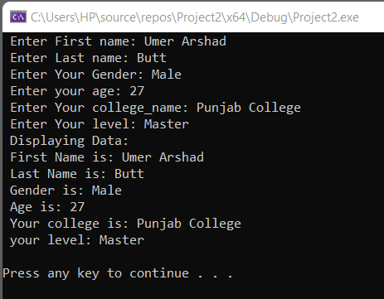
Example: Single inheritance (output)

Slide 15
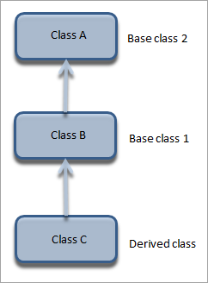
2.Multilevel Inheritance
A derived class with one base class and that base class is a derived class of another is called multilevel inheritance.

Slide 16
Multilevel Inheritance Syntax
class A // base class
{
...........
};
class B : acess_specifier A // derived class
{
...........
} ;
class C : access_specifier B // derived from derived class B
{
...........
} ;

Slide 17
Class Activity
Declare the base class student.
Define protected three data members rollno, marks1 & marks2.
Declare and define the function get() to get data members rollno, marks1 & marks2.
Declare the other class sports, derived from student
Define one protected data member sports marks.
Declare and define the function getsm() to get the sports mark.
Create the class statement derived from sports.
Declare and define the function display() to find out the total and average.
Declare the derived class object & call the functions get(), getsm() and display().

Slide 18
Example: Multi level inheritance (main.cpp)
#include<iostream>
#include "Header.h"
using namespace std;
int main()
{
statement obj1;
obj1.get(101, 77, 88);
obj1.getsm(67);
obj1.display();
cout << endl;
system("pause");
}

Slide 19
Example: Multi level inheritance (Header.h)
#pragma once
using namespace std;
class base {
protected:
int roll_no;
int marks1;
int marks2;
public:
void get(int R, int M1, int M2);
};
class sports :public base {
protected:
int s_marks;
public:
void getsm(int SM);
};
class statement : public sports {
private:
float total;
float avg;
public:
void display();
};

Slide 20
Example: Multi level inheritance (Source1.cpp)
#include<iostream>
#include<string>
#include<string.h>
#include "Header.h"
using namespace std;
void base::get(int R, int M1, int M2)
{
roll_no = R;
marks1 = M1;
marks2 = M2;
}
void sports::getsm(int SM)
{
s_marks = SM;
}
void statement::display() {
total = s_marks + marks1 + marks2;
avg = (total/300)*100 ;
cout << " Total Marks: " << total << endl;
cout << " Average: " << avg << endl;
}

Slide 21

Example: Multi level inheritance (output)

Slide 22
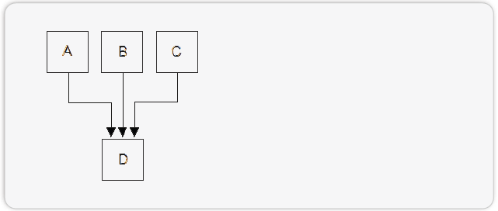
3. Multiple Inheritance
A derived class with multiple base class is called multiple inheritance

Slide 23
Multiple Inheritance Syntax
class A
{
...........
};
class B {
...........
} ;
class C : access_specifier A, access_specifier B, // derived from derived class A and B
{
...........
} ;

Slide 24
Class Activity
Declare the base class std_address
Define two data members *name & *city
Declare the function input_addr() and print_addr to get input and print for data members
Declare the other class std_marks
Define data members subj1, subj2, subj3, avg and total of std_marks
Declare the function input_marks() and show_marks() to get input and print data members
Create the class std_result derived from std_address and std_marks
Declare the function display() to find out the total and average
Declare the derived class object & call the functions

Slide 25
Example: Multiple inheritance (main.cpp)
#include<iostream>
#include "Header.h"
using namespace std;
int main()
{
std_results obj1;
obj1.input_addr(" Umer Arshad ", " Sialkot ");
cout << obj1.print_name();
cout << obj1.print_city();
obj1.input_marks();
obj1.show_marks();
obj1.display2();
cout << endl;
system("pause");
}

Slide 26
Example: Multiple inheritance (Header.h)
#pragma once
using namespace std;
class base {
protected:
int roll_no;
int marks1;
int marks2;
public:
void get(int R, int M1, int M2);
};
class sports :public base {
protected:
int s_marks;
public:
void getsm(int SM);
};
class statement : public sports {
private:
float total;
float avg;
public:
void display();
};

Slide 27
Example: Multiple inheritance (Source1.cpp)
char* std_address::print_name()
{
cout << " Name: " << endl;
cout << "\t";
return name;
}
char* std_address::print_city()
{
cout << "\n";
cout << " City: " << endl;
cout << "\t";
return city;
}
void std_address::display()
{
cout << " Name is: " << print_name() << endl;
cout << " City: " << print_city();
}
#include<iostream>
#include<string>
#include<string.h>
#include "Header.h"
using namespace std;
void std_address::input_addr(const char* adr,const char* CITY)
{
int length = strlen(adr);
name = new char[length];
for (int i = 0; i < length; i++)
{
name[i] = adr[i];
}
name[length] = '\0';
int length2 = strlen(CITY);
city = new char[length2];
for (int i = 0; i < length2; i++)
{
city[i] = CITY[i];
}
city[length2] = '\0';
}
void std_marks::input_marks()
{
cout << "\n";
cout << " Enter Subject Marks1: ";
cin >> subj1;
cout << " Enter Subject Marks2: ";
cin >> subj2;
cout << " Enter Subject Marks3: ";
cin >> subj3;
}

Slide 28
Example: Multiple inheritance (Source1.cpp)
void std_marks::show_marks()
{
cout << " Subject Marks1: " << subj1 << endl;
cout << " Subject Marks2: " << subj2 << endl;
cout << " Subject Marks3: " << subj3 << endl;
}
void std_results::display2()
{
total = subj1 + subj2 + subj3;
avg = ( total / 300 ) * 100;
cout << " Total Marks: " << total << endl;
cout << " Average: " << avg << endl;
}

Slide 29
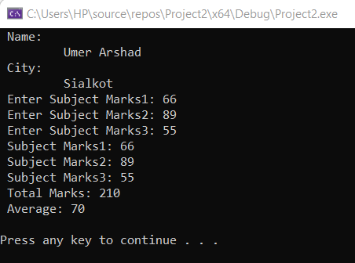
Example: Multiple inheritance (output)

Slide 30
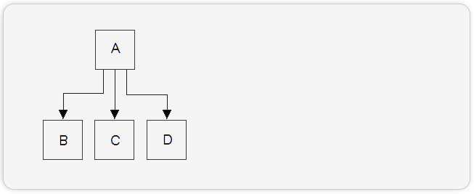
4. Hierarchical Inheritance
Multiple derived classes with same base class is called hierarchical inheritance.

Slide 31
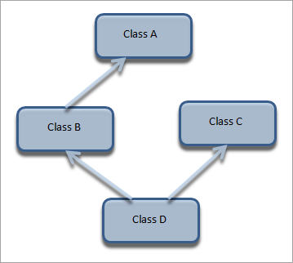
5. Hybrid Inheritance
Hybrid inheritance is usually a combination of more than one type of inheritance. In the below representation, we have multiple inheritances (B, C, and D) and multilevel inheritance (A, B, and D) to get a hybrid inheritance.

Slide 32
5. Hybrid Inheritance (Syntax)
class A
{
//class specific code;
};
class B : accessspecifier A
{
//class specific code;
};
class C
{
//class specific code;
};
class D : accessspecifier B, accessspecifier C
{
//class specific code;
};

Slide 33
Class Activity
Declare the base class student
Define two data members id & name
Declare the function getstudent() to get input for data members
Declare the other class marks inherited from student
Define data members marks_math,marks_phy, and marks_chem
Declare the function get_marks() to get input for data members
Declare the base class sports
Define data member of spmarks
Declare the function getsports() to get input for data members
Create the class result derived from marks and sports
Declare the function display() to find out the total and average
Declare the derived class object & call the functions

